Slide 1
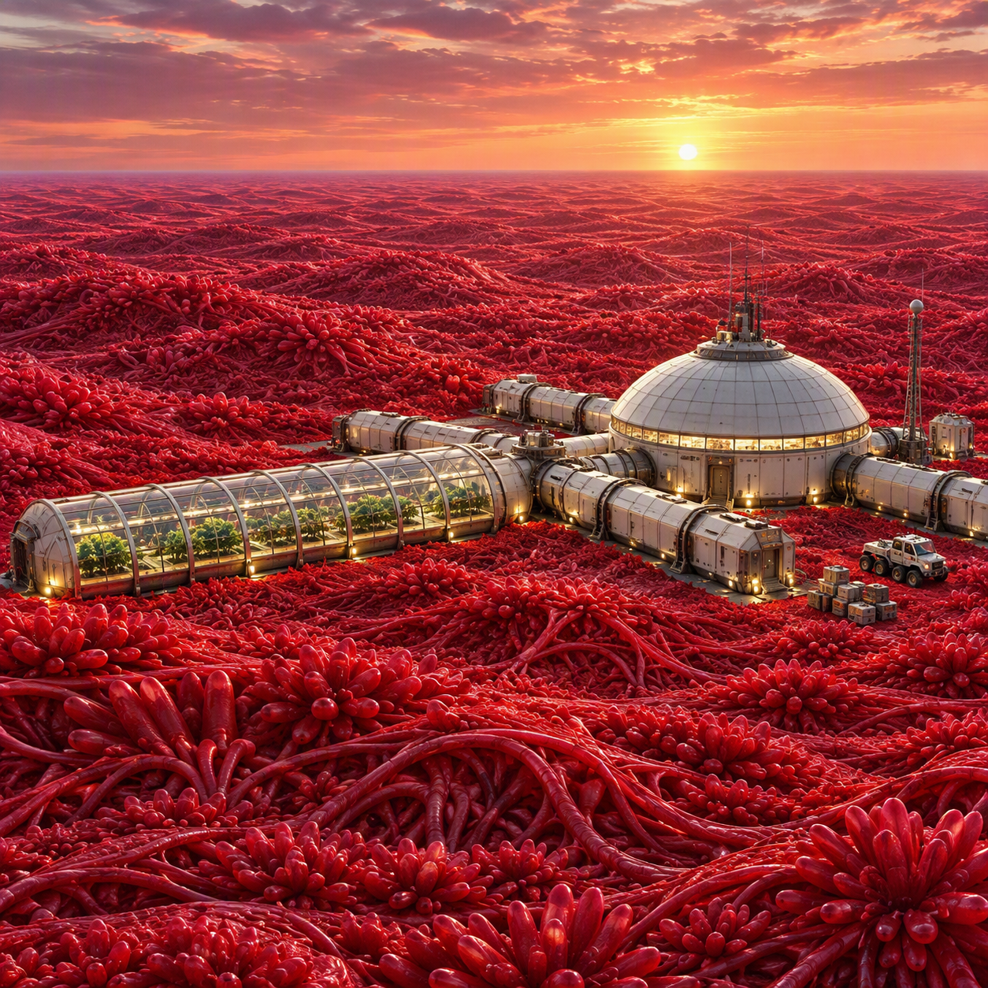
KEPLER-438b
EARTH IS GONE.
THE NEW WORLD IS ALIVE.
Eight-part limited television series
Based on the novel by W. D. Smart
Notes:
[Sources]
Visual on this slide was generated with Microsoft Copilot.
Story and adaptation content derived from the author’s Kepler-438b manuscript and TV pitch materials.
[/Sources]

Slide 2
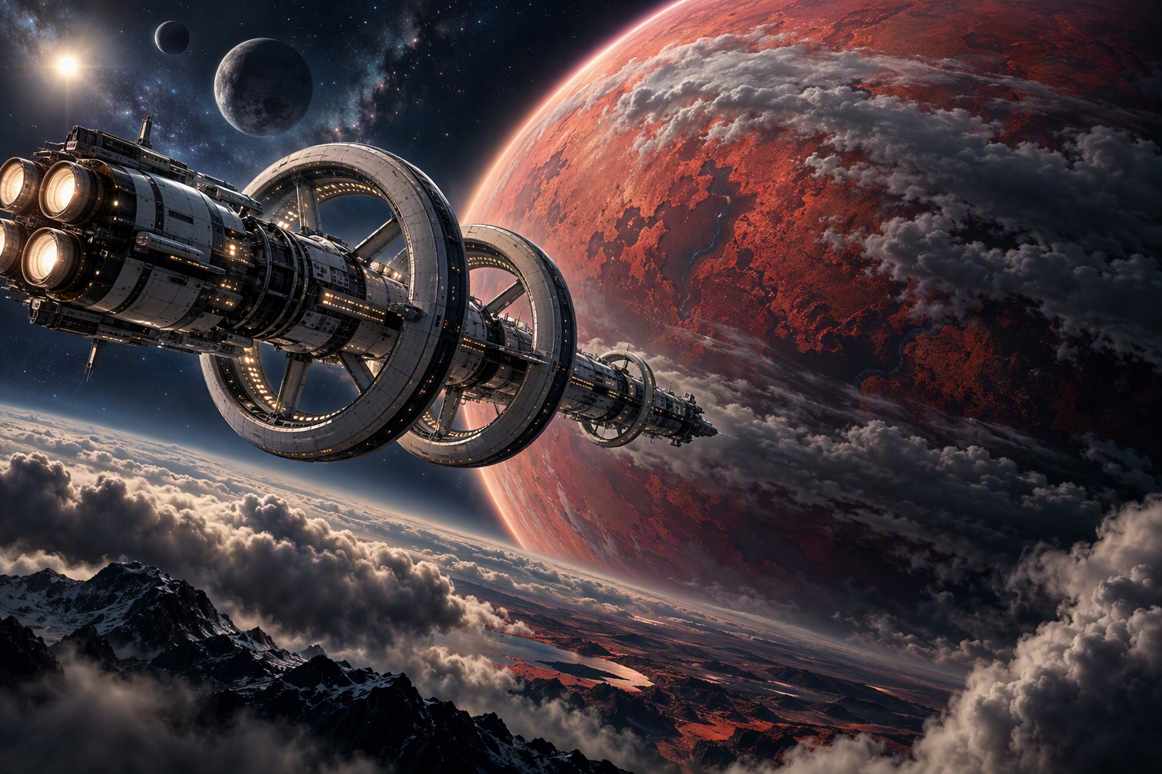
THE PREMISE
A one-way mission. A designed future. A living world.
Centuries after Earth’s collapse, six colonists awaken aboard the wrong ship, bound for Kepler-438b. Building humanity’s last settlement reveals two hidden threats: former rulers engineered the genetic future for themselves, and the planet is mounting an immune response against the human infestation.
SCIENCE-FICTION MYSTERY • SURVIVAL DRAMA • ECOLOGICAL THRILLER
For audiences of The Expanse, Silo, and For All Mankind.
Notes:
[Sources]
Visual on this slide was generated with Microsoft Copilot.
Story and adaptation content derived from the author’s Kepler-438b manuscript and TV pitch materials.
[/Sources]

Slide 3
THE STORY ENGINE
Every solution creates a new vulnerability.
ALTERED MISSION
BUILD THE COLONY
PLANETARY RESPONSE
Who changed the destination and selected these colonists?
Food, shelter, power, children, and governance must begin immediately.
The red groundcover shifts from resource to warning to immune system.
Answers create larger questions. Success narrows the moral choices.

Slide 4
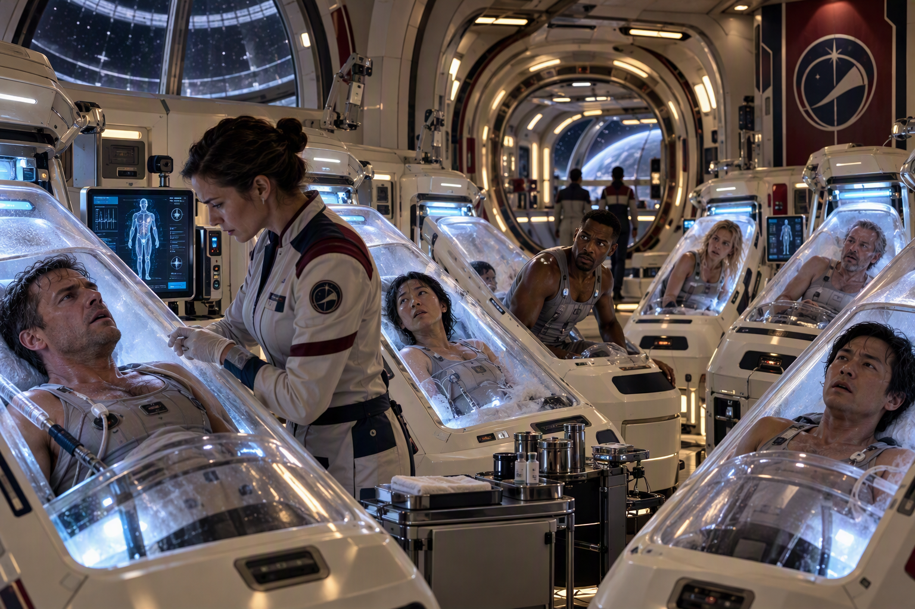
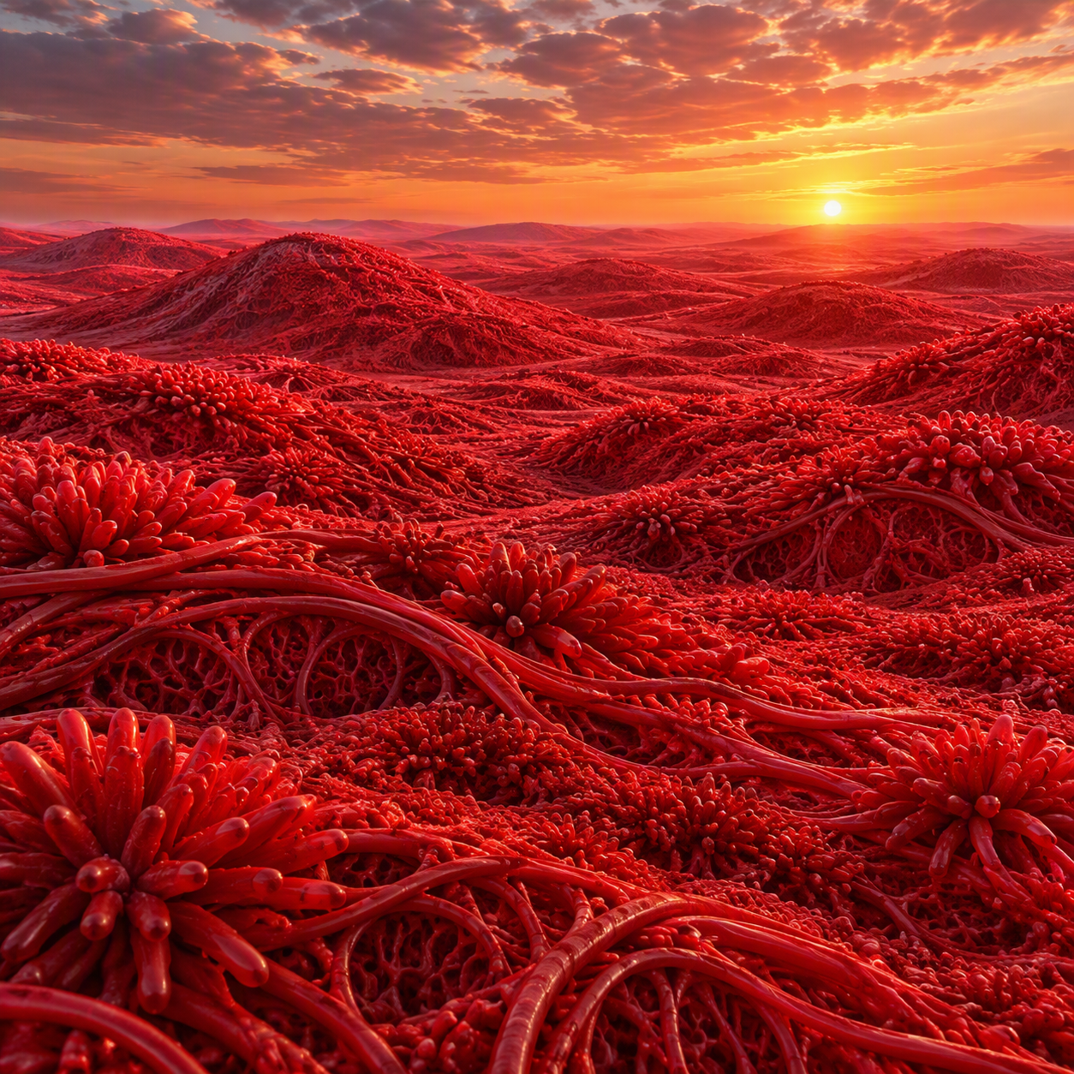
THE WORLD
Three visual systems create one escalating experience.
ILITHYA-2
THE PLANET
THE SETTLEMENT
Enroute
Yuzhiwu Ecosystem
Colonization
Notes:
[Sources]
Visual on this slide was generated with Microsoft Copilot.
Story and adaptation content derived from the author’s Kepler-438b manuscript and TV pitch materials.
[/Sources]

Slide 5
THE ENSEMBLE
Professional roles generate conflict, action, and story.
JOHN
XIA
ZAWADI
Guardian • moral witness
Guardian • emotional center
Engineer • stabilizing leader
MALCOLM
GAGANDEEP
WAN
Engineer • challenger
Nutritionist • scientist
Nutritionist • community builder
HERNANDEZ
MACTAVISH
ANA
Captain • compromised authority
Physician • tragic antagonist
AI • witness and gatekeeper

Slide 6
EIGHT-EPISODE ARC
A complete limited series with a definitive ending.
1
WAKING UP
2
WELCOME ABOARD
3
DISCOVERY
4
LANDING
5
FOOTHOLD
6
SETTLING IN
7
HARBINGERS
8
IMMUNE RESPONSE
MYSTERY → DISCOVERY → FRAGILE HOPE → ECOLOGICAL HORROR
Complete limited series with a franchise expansion potential.

Slide 7
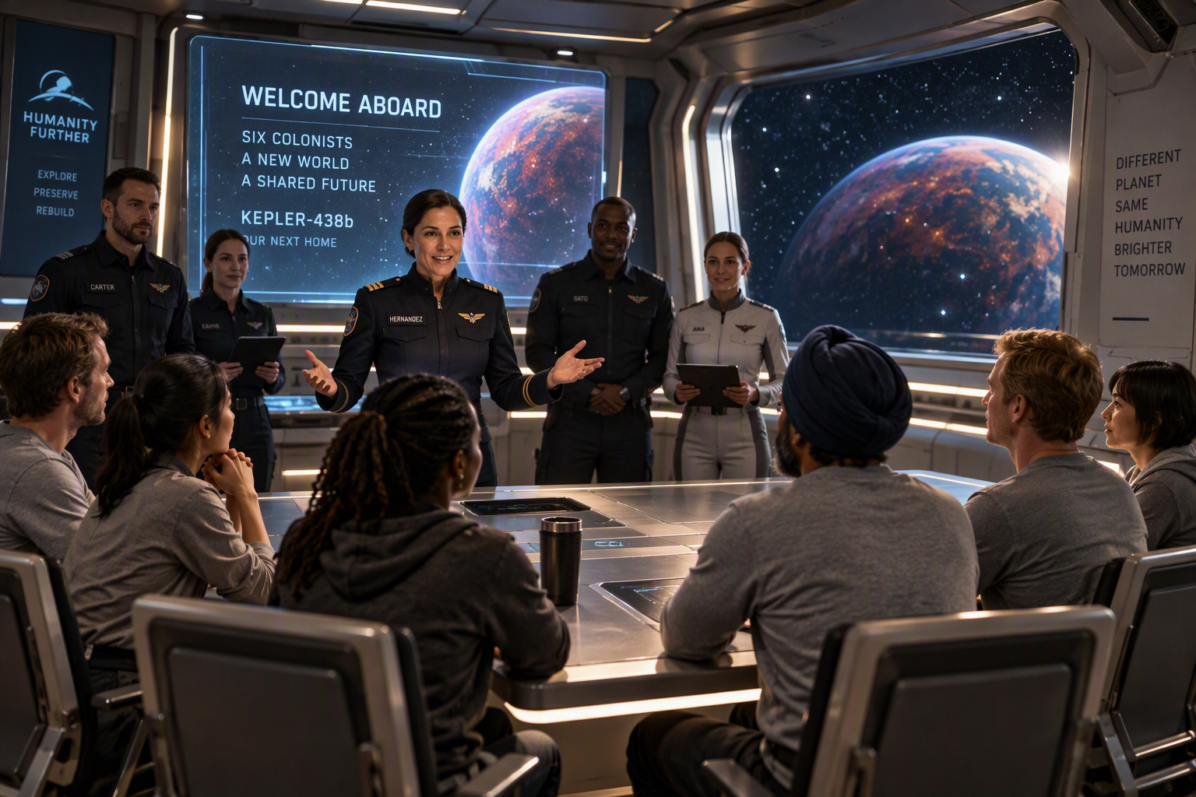
PILOT: “WAKING UP”
The audience learns the truth at the same pace as the colonists.
01
John wakes from a jungle dream inside a cryogenic pod.
02
Six colonists discover mismatched teams and an altered mission.
03
Changing gravity and restricted systems make information the first scarce resource.
04
The captain reveals that more than seven hundred Earth-years have passed.
05
Ana announces: Kepler-438b is one week away.
Notes:
[Sources]
Visual on this slide was generated with Microsoft Copilot.
Story and adaptation content derived from the author’s Kepler-438b manuscript and TV pitch materials.
[/Sources]

Slide 8
THEMES
The spectacle is planetary. The conflict is human.
SURVIVAL vs. HUMANITY
WHO OWNS THE FUTURE?
Is preserving human biology enough?
The zygote archive turns reproduction into political power.
RESTRICTED TRUTH
LOVE IN A DESIGNED SOCIETY
Authority withholds information while demanding trust.
Genuine attachment grows inside assigned roles.
ECOLOGY OF CONSEQUENCE
FAREWELL
Every intervention changes the world that is changing them.
What do people owe those they cannot save?

Slide 9
PRODUCTION APPROACH
Contained foundations. Expanding visual scale.
• Reusable shipboard sets anchor early episodes.
• Ilithya-2 components are redressed as colony architecture.
• Holograms and Ana turn exposition into dramatic conflict.
• A controlled cream palette on the ship and a red palette on the planet enhances identity.
• Major effects concentrate on approach, landing, vistas, and final takeover.
Notes:
[Sources]
Visual on this slide was generated with Microsoft Copilot.
Story and adaptation content derived from the author’s Kepler-438b manuscript and TV pitch materials.
[/Sources]

Slide 10
THE FINAL QUESTION
If a planet is alive at the scale of an ecosystem, is human colonization settlement, infection, or invasion?
KEPLER-438b
W. D. Smart • Kepler-438b@BillSmart.com
Film and television rights available for representation, option, and development
Notes:
[Sources]
Visual on this slide was generated with Microsoft Copilot.
Story and adaptation content derived from the author’s Kepler-438b manuscript and TV pitch materials.
[/Sources]

